Slide 1
System Analysis and Design
Unit 2: Planning

Slide 2
Identification and Selection of System Development Projects
1st phase of the SDLC is planning, consisting of
Project Identification and Selection
Project Initiation and Planning

Slide 3
Project Initiation and Planning
The first, project identification and selection, focuses on the activities where need for a new or enhanced system is recognized.
is often thought of as a “pre project” step in the life cycle.
The next step is to conduct a more detailed assessment during project initiating and planning.
This assessment does not focus on how the proposed system will operate
but rather on understanding the scope of a proposed project
and its feasibility of completion given the available resources.

Slide 4
Process of Initiating and Planning IS Development Projects
Two major activities occur during project initiation and project planning:
Project initiation
focuses on activities that will help organize a team to conduct project planning.
one or more analysts are assigned to work with a customer to establish work standards and communication procedures.

Slide 5
Six activities performed during project initiation are:
Establishing the Project Initiation Team
Establishing a Relationship with the Customer
Establishing the Project Initiation Plan
Establishing Management Procedures
Establishing the Project Management Environment and Project Workbook
Developing the Project Charter

Slide 6
2. Project Planning
focuses on defining clear, discrete tasks and the work needed to complete each task.
Objective - is to produce two documents:
a baseline project plan (BPP) and
the project scope statement (PSS).

Slide 7
BPP - baseline project plan
becomes the foundation for the remainder of the development project.
is an internal document used by the development team but not shared with customers.
b. PSS - project scope statement
produced by the project team,
clearly outlines the objectives of the project for the customer.

Slide 8
In project initiation process, the size, scope, and complexity of a project helps to understand the project planning process and the resulting documents.
Range of activities performed during project planning are:
Describing the Project Scope, Alternatives, and Feasibility
Dividing the Project into Manageable Tasks
Estimating Resources and Creating a Resource Plan
Developing a Preliminary Schedule
Developing a Communication Plan
Determining Project Standards and Procedures
Identifying and Assessing Risk
Creating a Preliminary Budget
Developing the Project Scope Statement
Setting a Baseline Project Plan

Slide 9
Assessing Project Feasibility
A feasibility study is an analysis that considers all of a projects relevant factors including economic, technical, legal and scheduling considerations to ascertain the likelihood of completing the project successfully.
Feasible-possible to do
All projects are feasible given unlimited resources and infinite time
Unfortunately, most projects must be developed within tight budgetary and time constraints.
Assessing project feasibility is a required task for all projects and
requires that a systems analyst evaluate a wide range of factors.

Slide 10
Whether a project as feasible or not depend on several factors, including project’s cost and return on investment.
Why do we need feasibility study?
We need feasibility study for following reasons:
It helps to define our goals and objectives.
It helps us to develop a plan
It helps to execute the developed plan
It gives us an identity
It improves the attention of project teams.
Reduces the number of business options.

Slide 11
Types:
Economic
Technical
Operational
Scheduling
Legal and contractual
Political

Slide 12
Economic Feasibility
Referred as cost–benefit analysis
identify costs and financial benefits associated with the development project
analyses if the expected benefit equal or exceed the expected costs,
During project initiation and planning, it well be impossible for us to define precisely all benefits and costs a related to a particular project.
We review worksheets to record costs and benefits.
These worksheets are used after each SDLC phase to decide whether to continue, redirect, or kill or project.

Slide 13
2. Technical Feasibility
to evaluate whether system will perform adequately and whether an organization has ability to construct a proposed system, or not.
All projects have risk and that risk is not necessarily something to avoid.
Organizations typically expect a greater return on their investment for riskier projects.
Potential risks need to be identified as early as possible in their project.

Slide 14
The amount of technical risk associated with given project depends on four primary factors:
project size,
project structure,
the development group's experience with the application and technology area,
and the user group's experience with systems development projects and the application

Slide 15
﻿3. Operational Feasibility
evaluate whether a system will work or not
Evaluate whether the proposed system will likely to solve business problems, and take advantage of opportunities or not.
It is important to understand how the new systems will fit into the current day-to-day operations of the organization.
A workable solution might fail because of the end-user such as how long will the working environment of the end-users change, or whether end-users will adopt to that change.

Slide 16
4. Schedule Feasibility
determine the duration of the project
whether it is too long to be complete before it is useful.
System analysts have to estimate how long the system will take to develop.
Furthermore the learning curve of the new technology and new system should be considered.
We may have the new technology, but that doesn't mean we have the skills required to properly apply that technology.
Even though all information system professionals technologies, the learning curve will specifically impact the schedule feasibility.

Slide 17
5. Legal and Contractual Feasibility
determines whether the proposed system conflicts with the legal requirement or not.
A project may face legal issues after completion of project or during the development of project.
The possible considerations might include copyright, labour laws, creation of data to share data with other organizations etc.

Slide 18
6. Political Feasibility
Understand how key stake holders within the organization view the proposed system.
Information system may affect the distribution of information within the organization and thus the distribution power.
Those stakeholders who do not support the project may take steps to block, disrupt or change the intended focus of the project.

Slide 19
Economic/Cost-benefit analysis
Determining Project Benefits
Information system can provide benefit to an organization
Project Benefits are both tangible and intangible.
Tangible benefits
refer to items that can be measured in dollars and with certainty.
All tangible benefits can be easily quantified.
Eg, reduced personnel expenses, lower transaction cost, higher profit margins, error reduction, increased speed of activity, opening new sales opportunities

Slide 20
2. Intangible benefits
refer to items that cannot be measured in dollars and with certainty.
These benefits have direct organizational benefits, such as
improvement of employee morale
Faster decision making
Improved efficiency
Flexibility
Availability of new information

Slide 21
Determining Project Costs
Similar to benefits, an information system can have both tangible and intangible costs.
1. Tangible costs
refer to items that can be measured in dollars and with certainty.
Eg, hardware costs, labor costs, and operational costs including employee training and building renovations.
2. Intangible costs
Can not be measured in dollars and with certainty.
Eg, loss of customer goodwill, employee morale, or operational inefficiency.

Slide 22
Goal of a cost–benefit analysis
One goal of a cost–benefit analysis is to accurately determine the total cost of ownership (TCO) for an investment.
TCO is focused on understanding
total cost of acquisition as well as
all costs associated with ongoing use and maintenance of a system.
Also determine development costs as either
onetime cost or
recurring cost

Slide 23
One-time costs
refer to the cost associated with project initiation and development and the start-up of the system.
These costs typically encompass activities such as
systems development
new hardware
software purchases
user training
site preparation
data or system conversion

Slide 24
Recurring costs
refer to those costs resulting from the ongoing evolution and use of the system.
Examples of these costs typically include
Application software maintenance
Incremental data storage expenses
Incremental communications
New software and hardware leases
Supplies and other expenses (e.g., paper, forms, data center personnel)

Slide 25
Both one-time and recurring costs can consist of items that are fixed or variable in nature.
1. Fixed costs
are costs that are billed or incurred at a regular interval and usually at a fixed rate
Eg, a facility lease payment
2. Variable costs
are items that vary in relation to usage
Eg, long-distance phone charges

Slide 26
The Time Value of Money (TVM)
time = money concept
reflects the notion that money available today is worth more than the same amount tomorrow.
i.e. compares present cash outlays to future return
the development of an information system has both one-time and recurring costs.
also, benefits from systems development will likely occur sometime in the future.
all costs and benefits must be viewed in relation to their present value when comparing investment options.
Eg, worth of a company now vs after 5 years

Slide 27

Cost-Benefit Analysis Techniques
Net Present Value (NVP)
Present value is the current value of a dollar at any in the future. It is calculated
Where,
PVn is present value of Y dollars in n years from now when i is the discount rate.
To calculate net present value (NVP), simply add the present values calculated previously.
(Discount Rate or cost of capital- The rate at which money can be borrowed or invested.)

Slide 28
2. Return on Investment (ROI)
is the ratio of net cash receipts of the project divided by the cash outlays the cash outlays of the project.
Firms choose the project that provides the highest ROI.
Expressed as:
Overall return on investment (ROI) = Overall NPV
NPV of all costs

Slide 29
2. Break-Even Analysis (BEA)
is a type of cost-benefit analysis to identify at what point benefits equal costs.
usually expressed as amount of revenue, that must be realized for the firm to have neither profit or loss.
It uses a minimum revenue target.
It can be expressed in numbers or by use of graphs
Break-even ratio (BEA) = Yearly NPV cash flow - Overall NPV cash flow Yearly NPV cash flow

Slide 30
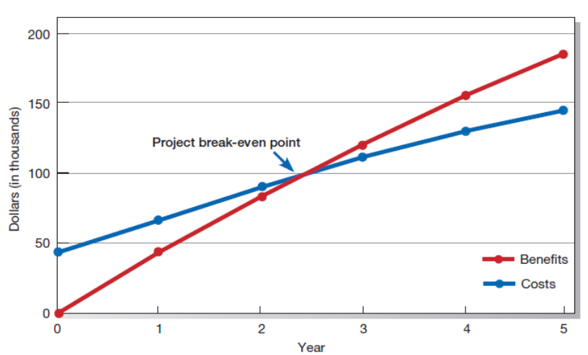

Slide 31
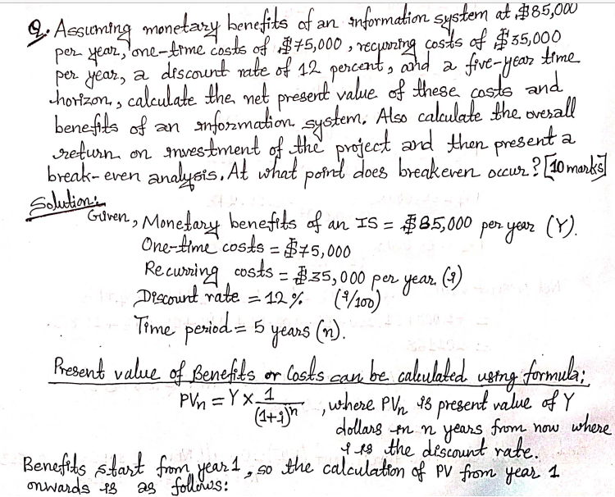

Slide 32


Slide 33
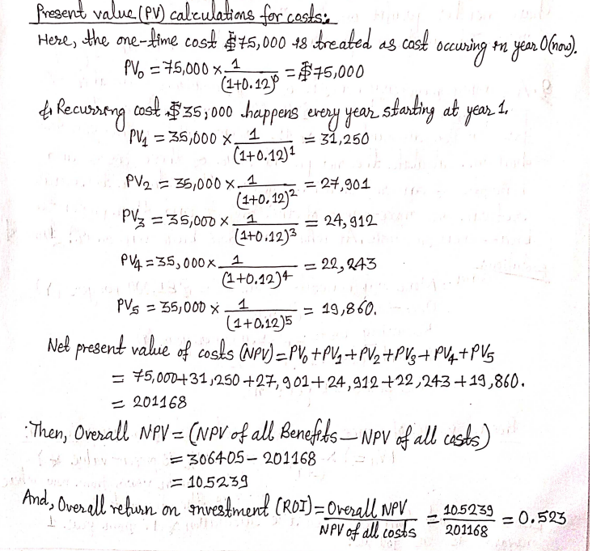

Slide 34
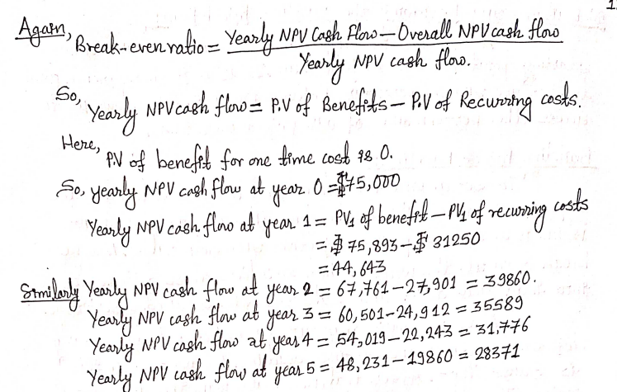

Slide 35
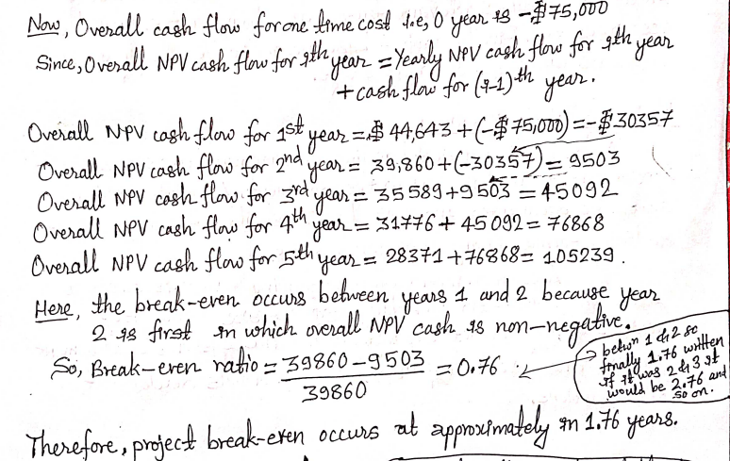

Slide 36
Q2. A system costs Rs.1,00,000 to install and Rs.8000 per month as recurring expenses. The benefit per year is Rs.1,50,000. Assuming interest rate 12%, what is payback period of investment?
Solution:
One Time cost = 1,00,000
Recurring cost = 8000 per month= 8000*12= 96000
Benefit= 1,50,000
Interest rate= 12%
Payback period = ?
Ans= 2.22 year

Slide 37
Q3. Assume monetary benefits of an information system of $70,000 the first year and increasing benefits of $10,000 a year for the next four years, one-time development costs of $90,000, and recurring costs of $40,000 per year over the duration of the system’s life. The discount rate for the company was 11 percent. Using a five-year time horizon, calculate the net present value of these costs and benefits. Also, calculate the overall return on investment and then present a breakeven analysis. At what point does breakeven occur?
PV1= 70000*
PV2= 80000*
PV3= 90000*
PV4= 100000*
Ans=2.81

Slide 38
Q5. A system costs Rs.2,00,000 to install. The profit per year is Rs.50,000. Assuming interest rate 6%, what is payback period of investment?
Solution:
One Time cost = 2,00,000
Benefit= 50,000
Interest rate= 6%
Payback period = ?

Slide 39
PV for benefit
PV1= 50000*(1/(1+6%)^1)= 47169
PV2 = 50000*(1/(1+6%)^2)= 44499
PV3 = 50000*(1/(1+6%)^3)= 41980
PV4 = 50000*(1/(1+6%)^4)= 39604
PV5 = 50000*(1/(1+6%)^5)= 37362
Payback period
Overall cash flow for one time cost for Year 0= -200000
Overall cash flow for one time cost for Year 1= 47169+ (-200000)= -152831
Overall cash flow for one time cost for Year 2= 44499 + (- 152831)= -108332
Overall cash flow for one time cost for Year 3= 41980 + (- 108332)= -66352
Overall cash flow for one time cost for Year 4= 39604 + (- 66352)= -26748
Overall cash flow for one time cost for Year 5= 37362 + (- 26748)= 10614

Slide 40
Break even ratio= (37362-10614)/37362= 0.71
Break even occurs between year 4 and 5 so, payback period is 4.71 years.

Slide 41
Q6. Initial investment in initial month= Rs.1,50,000
Interest rate = 8%, per month
Benefit in 1st month = Rs.40,000.
Following 2 month benefit increases by Rs. 20000
but last month benefit is only Rs. 70000
Calculate payback period of investment?

Slide 42
Soln:
PV1= 40000*(1/(1+8%)^1)=
PV2 = 60000*(1/(1+8%)^2)=
PV3 = 80000*(1/(1+8%)^3)=
PV4 = 70000*(1/(1+8%)^4)=
Ans=2.54 month

